Slide 1
Video prediction using Gated Spatial - Temporal Attention (gSTA) modules
Mattia Castelmare 1815675
Andrea Giuseppe di Francesco 1836928
Enrico Fazzi 2003876
Final project for Deep Learning course
Sapienza University of Rome
A.Y. 2022/2023

Slide 2
Table of contents
Introduction
Vanilla Encoder Decoder (First baseline)
SimVP (Second baseline)
SimVP2 (SOTA)
Final results
Conclusions

Slide 3
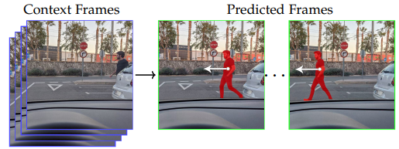
Task introduction
Video Prediction is the task of predicting future frames given past video frames (spatio-temporal predictive learning).
The predicted frames are produced by Deep Neural Network models.
In recent years several methods have been developed, these employed the use of famous architectures such as CNNs, RNNs and also ViT.
In this project, we explore some of the most recent methodologies, we compared 2 baseline models of increasing complexity with the current SOTA of the Moving MNIST (MMNIST) dataset.
The approaches presented here distinguish themselves for their simplicity, as they use only convolutional layers.
Castelmare - Di Francesco - Fazzi video prediction using gated spatio - temporal attention (gSTA) modules

Slide 4


Dataset - MMNIST (Moving MNIST)
From 0 to 10 frames
Moving MNIST contains videos in which two digits move independently around the frame.
Each sample is a 20 frames video: wherein the first 10 timesteps (input) are used to infer the subsequent 10 (groundtruth).
Each frame is a 64 x 64 grid with only one channel (greyscale).
Each sample is a tensor of shape T x H x W x C (T = 20, H = 64, W = 64, C = 1).
The entire dataset comprises 10k ~ training samples and 10k ~ testing samples.
We didn’t perform any data augmentation or preprocessing of the frames.
From 10 to 20 frames
Castelmare - Di Francesco - Fazzi video prediction using gated spatio - temporal attention (gSTA) modules

Slide 5
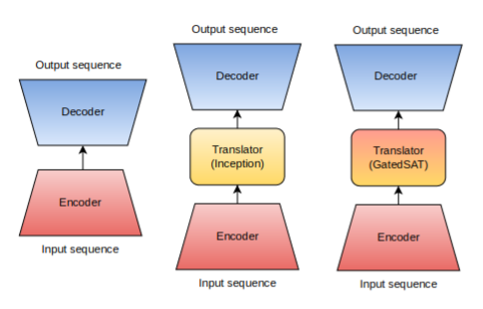
Spatiotemporal Predictive Learning (STPL)
The STPL aims to fully comprehends both spatial correlation and temporal evolution of the physical world.
In our experiments we trained DNNs with the scope of learning these features from the MMNIST dataset.
Thus, all the presented models exhibits specialized modules in capturing both spatial and temporal information.
Models:
Vanilla Encoder - Decoder
SimVP - Inception module [1]
SimVP2 - gSTA [2]
Castelmare - Di Francesco - Fazzi video prediction using gated spatio - temporal attention (gSTA) modules

Slide 6
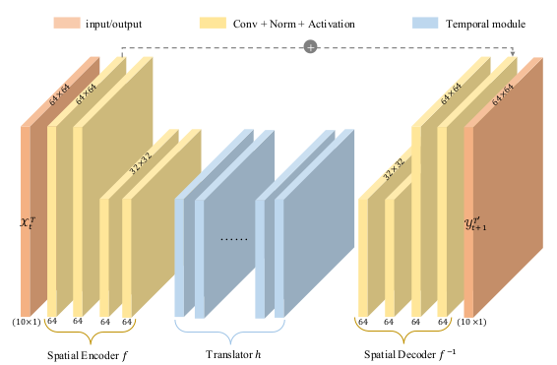
Vanilla Encoder Decoder
Our first baseline was a simple Vanilla Encoder Decoder.
This solution has the only purpose of providing a baseline to beat for the more advanced architectures.
According to some experiments each convolutional layer consisted of a ReLU activation function and a Group normalization layer. These choices were motivated by a small set of experiments.
This architecture exhibits evident issues in terms of performances.
Castelmare - Di Francesco - Fazzi video prediction using gated spatio - temporal attention (gSTA) modules

Slide 7
Vanilla Encoder Decoder (Drawbacks)
In the model that we illustrate here there is a common pattern to the architecture.
Generally the spatial features are captured by the convolutional layers, and the temporal ones are caught by a ‘Translator’.
In this case the Vanilla Encoder Decoder lack of the Translator block, for this reason it can’t represent the temporal variation in the frames.
Castelmare - Di Francesco - Fazzi video prediction using gated spatio - temporal attention (gSTA) modules

Slide 8
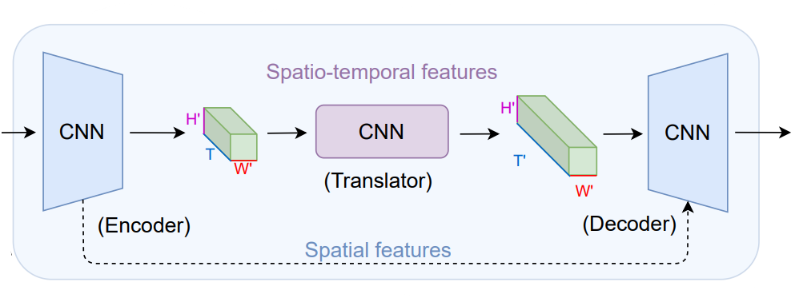
SimVP - Simpler but yet better Video Prediction
The second baseline presented is Simpler but better Video Prediction (SimVP).
It is articulated in an Encoder-Decoder fashion with a Translator module, that is the novelty of this approach.
The Encoder Decoder modules are respectively composed of a sequence: Conv2d/ConvTranspose2d + Group normalization + LeakyRelu.
The Translator architecture resembles a UNet that employees N Inception modules to learn temporal evolution.
Castelmare - Di Francesco - Fazzi video prediction using gated spatio - temporal attention (gSTA) modules

Slide 9
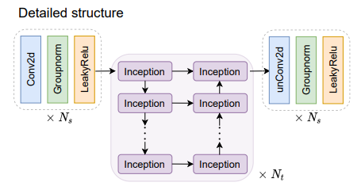
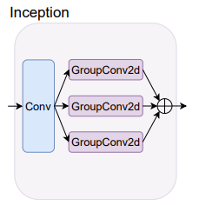
Translator and Inception module
The proposed Inception module is composed of the following operations:
bottleneck Conv2d with 1 x 1 kernel
parallel GroupConv2d operators with different kernels (3,5,7,11).
The concatenation of the different encoder-translator features with the decoder-translator ones in the UNet structure helps the model to extract temporal information from the videos.
The tensors processed have dimensions B x (TxC) x H x W in such a way that the temporal information is condensed in TxC.
Even though this architecture contains only Convolutional layers, the number of parameters increases dramatically with the number of inception modules.
Castelmare - Di Francesco - Fazzi video prediction using gated spatio - temporal attention (gSTA) modules

Slide 10
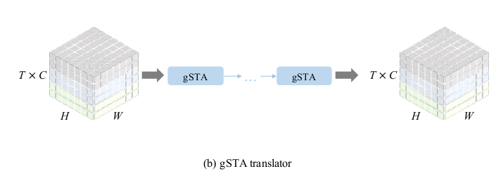
SimVP2 (gSTA)
The current SOTA is an alternative version of the SimVP with Inception module, recently proposed by their same authors.
Even though it presents the same training strategies, and Encoder-Decoder design, its gap in performances is due to the different design in the Translator block.
This block is referred to as Gated Spatio - Temporal Attention module, and it distinguishes itself for its ability to capture long temporal relationships between frames, with the solely use of CNNs.
Castelmare - Di Francesco - Fazzi video prediction using gated spatio - temporal attention (gSTA) modules

Slide 11
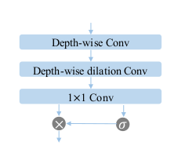
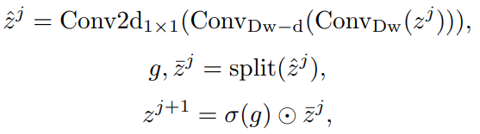
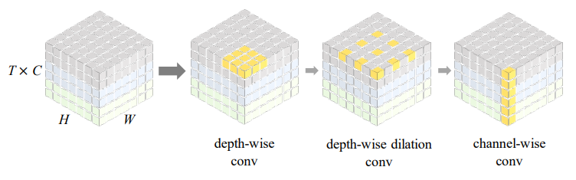
SimVP2 (gSTA)
Our implemented version of the SimVP2 follows the same proposed in [2], indeed we adopted a stack of 8 gSTA layers to encode the temporal information. This solution brought us beyond the documented results.
The spatiotemporal attention is emulated with a series of specific convolutional operation in the gSTAs.
This SimVP’s alternative, achieves better results, with a higher efficiency in terms of number of parameters.
Castelmare - Di Francesco - Fazzi video prediction using gated spatio - temporal attention (gSTA) modules

Slide 12
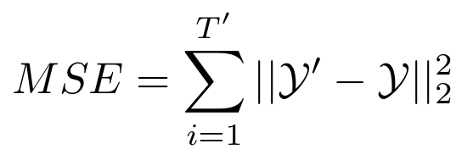
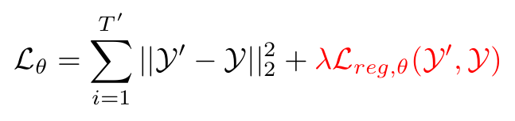
Metrics
The metrics used for training and testing all the models is a simple Mean Squared Error (MSE).
Although MSE is a standard loss function it is really effective for this task since there are no high frequency detail to capture in fact the frames are in grayscale and the scenes are simple (moving digits) [3].
Further improvements in term of performance can be achieved by adding a regularization term or another metric that can helps the model to learn better temporal feature.
In a different approach [4] the Kullback-Liebler divergence was used as a regularization term.
Castelmare - Di Francesco - Fazzi video prediction using gated spatio - temporal attention (gSTA) modules

Slide 13
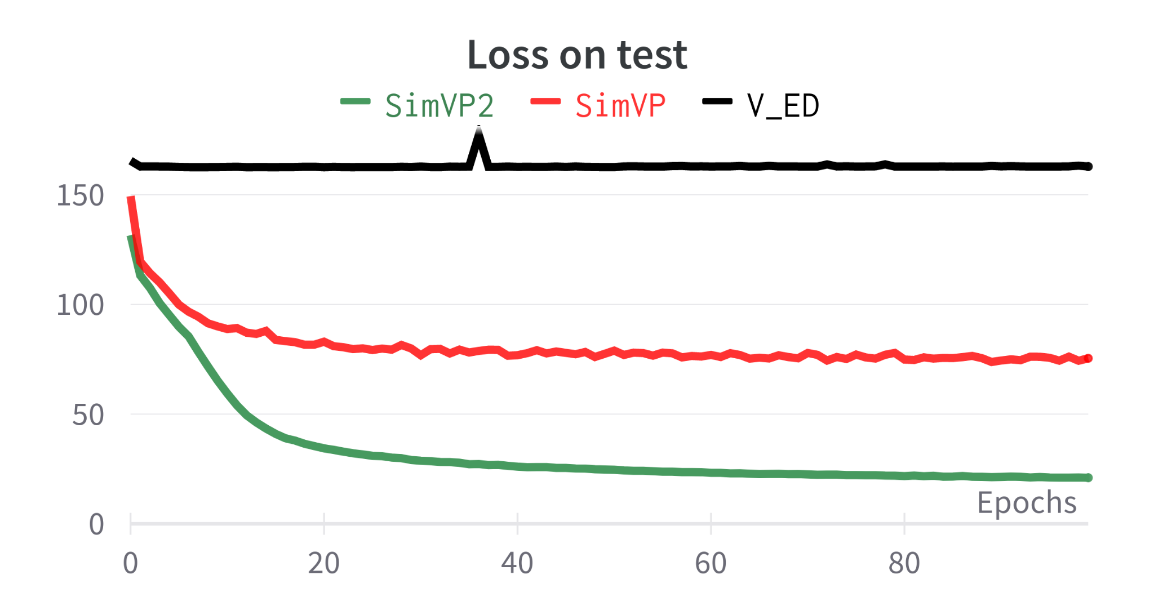
Results
To obtain satisfactory results we trained all the models for 100 epochs.
In figure are shown performances of the loss on the test set.
The different behaviours of the models can be clearly seen:
V-ED after few epochs finds a local minimum and doesn’t improve further.
SimVP loss decreases with a high slope for about 20 epochs then stabilises around a certain value and decreases with a slower rate.
SimVP2 loss has the same trend of the previous one but with a higher slope at the beginning that led to better performance.
Castelmare - Di Francesco - Fazzi video prediction using gated spatio - temporal attention (gSTA) modules

Slide 14
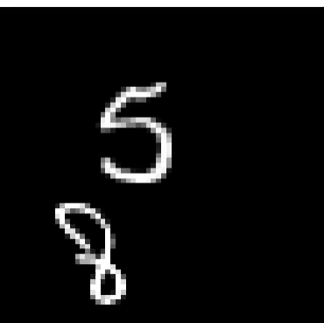
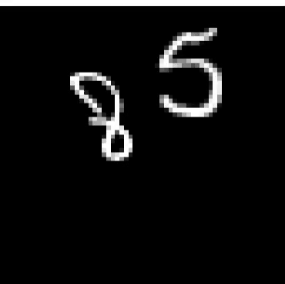
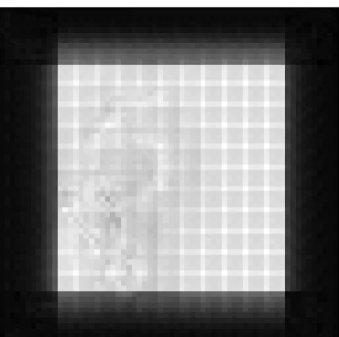
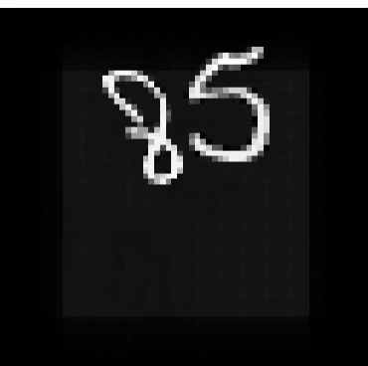
Predictions - Vanilla Encoder - Decoder
Input
Groundtruth
Output
|Groundtruth - output|
Due to the lack of the temporal module the model is not able to capture inter frames relationships but only the spatial ones. In fact, it seems that the model only attempts to reconstruct the input video.
Castelmare - Di Francesco - Fazzi video prediction using gated spatio - temporal attention (gSTA) modules

Slide 15
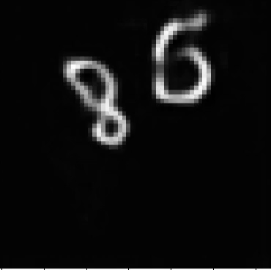
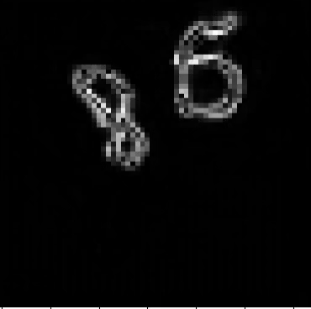
Predictions - SimVP
Input
Groundtruth
Output
|Groundtruth - output|
In this case, it is clear that the model learns to capture temporal features but only for the first 3/4 frames, then the numbers dissolve losing long range time dependency.
Castelmare - Di Francesco - Fazzi video prediction using gated spatio - temporal attention (gSTA) modules

Slide 16
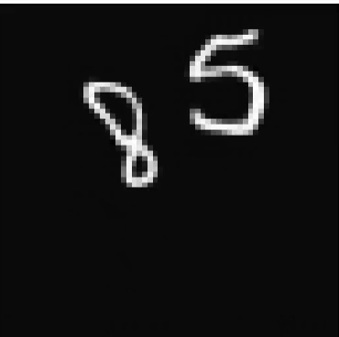
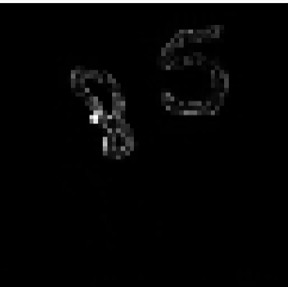
Predictions - SimVP2
Input
Groundtruth
Output
|Groundtruth - output|
The SOTA learns to correctly predict all the frames in the video with a very small error in the representation of the numbers.
Castelmare - Di Francesco - Fazzi video prediction using gated spatio - temporal attention (gSTA) modules

Slide 17
Comparison of the different predictions
Groundtruth
Vanille ED
SimVP
SimVP2
Here we can observe the performance of the 3 presented models.
Castelmare - Di Francesco - Fazzi video prediction using gated spatio - temporal attention (gSTA) modules

Slide 18
Conclusions
The obtained results are satisfactory despite the limited number of training steps in the whole set of experiments (100 compared to 1k~2k shown in the papers).
Further improvements in the performances have shown to be possible also with a reduction in the number of parameters (23.4MLN for SimVP and 11.4 MLN for SimVP2).
We evinced that the combination of specific convolutions (e.g. depth wise, dilation and channel-wise) was really effective in capturing temporal information.
In our opinion, future works should also consider the possibility of including more complex modules that would work with these convolutions.
Castelmare - Di Francesco - Fazzi video prediction using gated spatio - temporal attention (gSTA) modules

Slide 19
References
Papers:
[1] Z. Gao, C. Tan, L. Wu, and S. Z. Li, “Simvp: Simpler yet better video prediction,” 2022. [Online]. Available: https://arxiv.org/abs/2206.05099
[2] C. Tan, Z. Gao, and S. Z. Li, “Simvp: Towards simple yet powerful spatiotemporal predictive learning,” 2022. [Online]. Available: https://arxiv.org/abs/2211.12509
[3] D. Pathak, P. Krahenbuhl, J. Donahue, T. Darrell, and A. A. Efros, “Context encoders: Feature learning by inpainting,” 2016. [Online]. Available: https://arxiv.org/abs/1604.07379
[4] C. Tan, Z. Gao, S. Li, Y. Xu, and S. Z. Li, “Temporal attention unit: Towards efficient spatiotemporal predictive learning,” 2022. [Online]. Available: https://arxiv.org/abs/2206.12126
Images:
Source images at [1], [2].
Castelmare - Di Francesco - Fazzi video prediction using gated spatio - temporal attention (gSTA) modules

Slide 20
Thank you for the attention!
Mattia Castelmare 1815675
Andrea Giuseppe Di Francesco 1836928
Enrico Fazzi 2003876

